Slide 1
Preparation of Carboxymethyl Cellulose (CMC) solution to enhance CGA stability
(Design Project)
-Aryaman Das(2020CH10077)
-Avik Ghosh(2020CH10081)

Slide 2
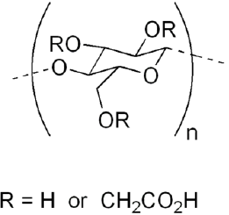
Carboxy Methyl Cellulose(CMC)
water-soluble derivative of cellulose
Substitution of hydroxyl groups of cellulose backbone with carboxymethyl groups(CH2-COOH)
polymer structure and entangled network
carboxylate group -> hydrophilicity
Shear thinning behavior

Slide 3
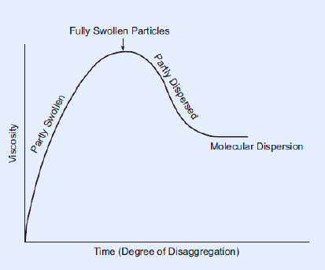
Dissolution mechanism of CMC Powder
Mechanism of Action:
Powder dispersion: Dry CMC needs to disperse in water to avoid lump formation
Hydration of Particle: The hydrophilicity leads the particles to swell.
Formation of hydrated chains: The cellulose backbone unwinds and hydrate --> more solubility
To ensure perfect mixing and no lump formation:
rigorous mixing
application of heat
CMC dissolution : viscosity vs time

Slide 4
Methods used for dissolution
Magnetic Stirring: Stirring with a magnetic flee with no heating.
Magnetic Stirring and Constant Heating: with flee but in the fixed plate temperature of 75 deg.
Stirring by spatula and smashing lumps: Using spatula and mixing by hand
Maximum Achieved concentration: 0.5% (lump formation afterward).
Time: 20-30 min
Maximum Achieved concentration: 1.5%
Time: 45-50 min
(lumps formation afterward)
Maximum Achieved concentration: 2%
Time: 30-40 min

Slide 5
Viscosity of CMC
1% solution in water at 25 deg C = 200-300 cps
A large range of viscosities are available depending on the degree of polymerization (DP).
With increasing CMC concentration, the viscosity is increasing nonlinearly.
Rule of thumb, doubling the CMC concentration will increase the viscosity of by a factor of 6–10.

Slide 6
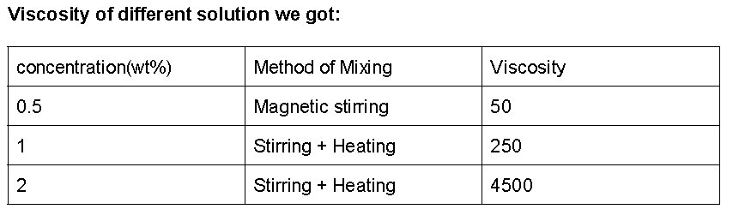
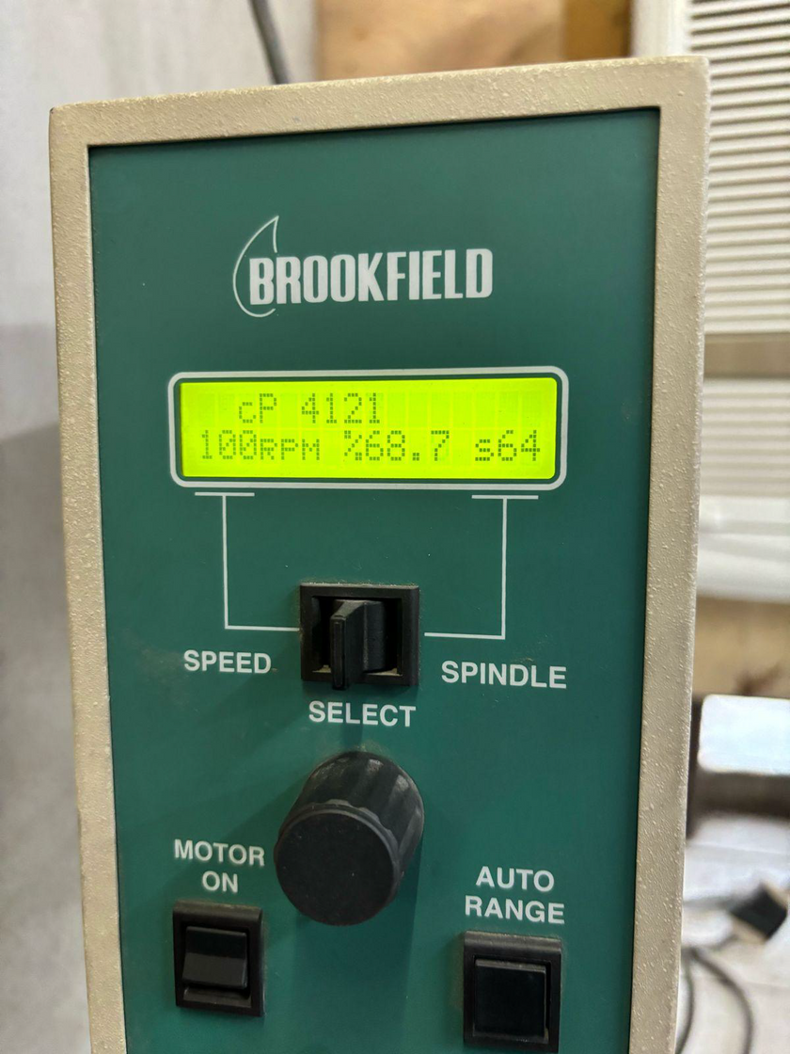
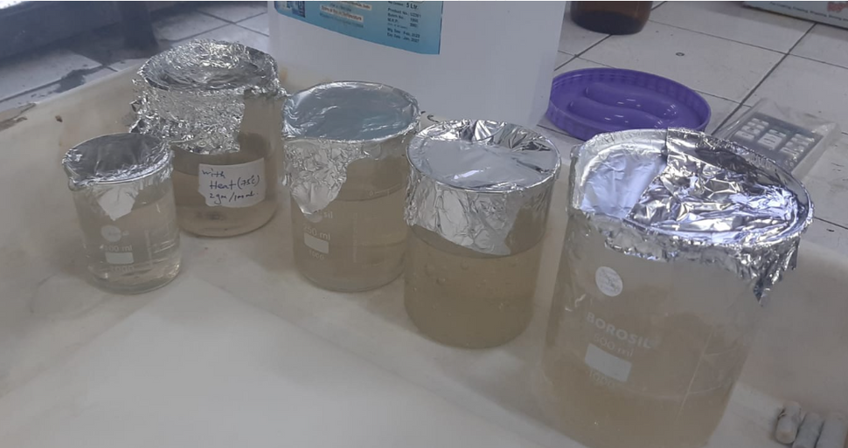
Experimental Results
Samples

Slide 7
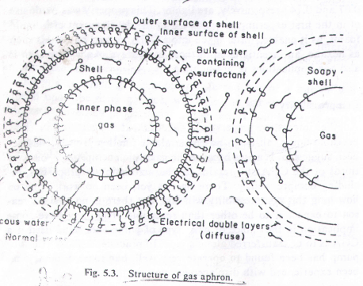
Colloid Gas Aphron (CGA)
unique colloidal systems comprising microbubbles dispersed in a continuous liquid phase.
Gas Injection:
Gas (e.g., air or hydrogen) is injected into a liquid containing surfactants or foaming agents under controlled conditions.
Agitation or mixing promotes the dispersion and stabilization of microbubbles.
Stabilization Mechanism:
Surfactants or foaming agents adsorb at the gas-liquid interface, forming a stable thin film around the microbubbles.
This film prevents coalescence

Slide 8
Properties of CGA
1) High Surface Area:
High surface area-to-volume ratio due to the small size of the gas bubbles
2) Stability:
The presence of surfactants imparts stability to CGA, preventing coalescence
3) Tunable Properties :
The properties of CGA, including size, stability, and rheological behavior, can be tailored by adjusting parameters such as surfactant concentration, gas type, and processing conditions.

Slide 9
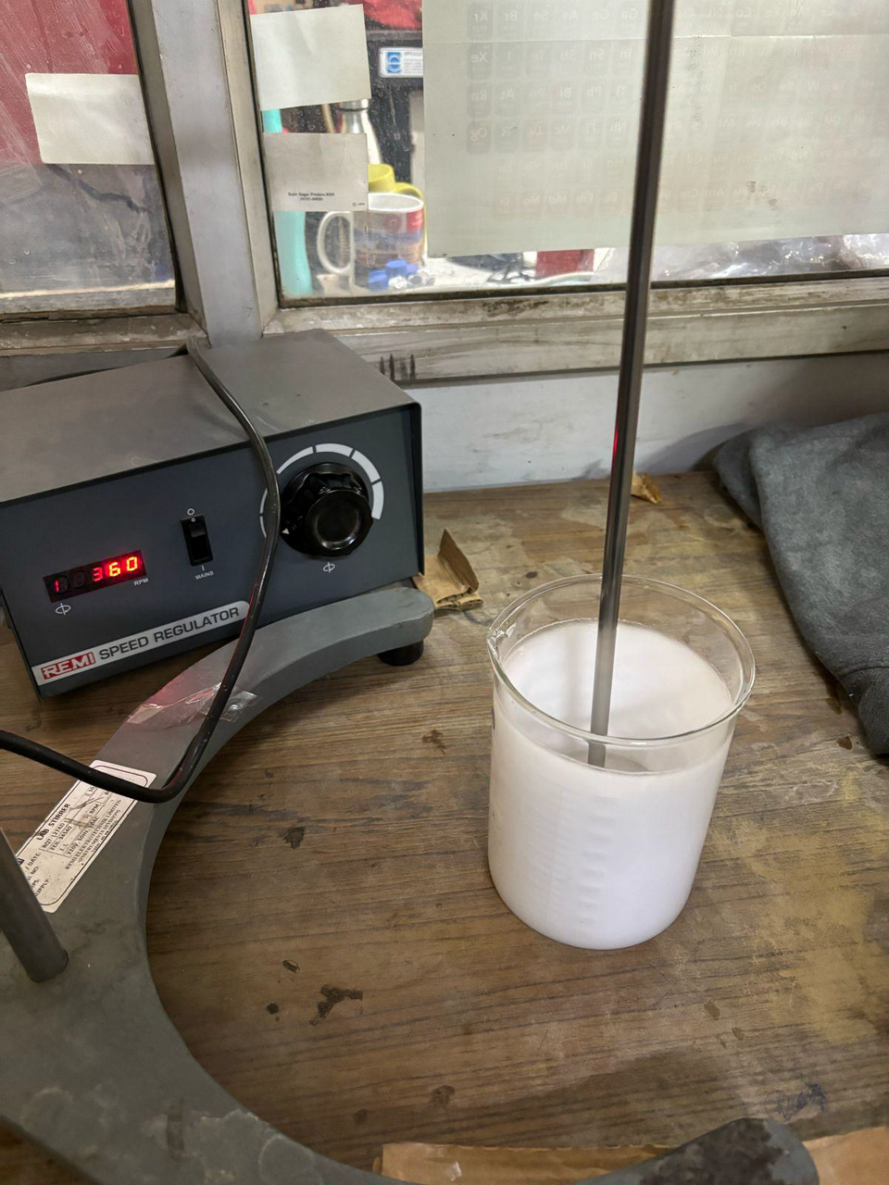
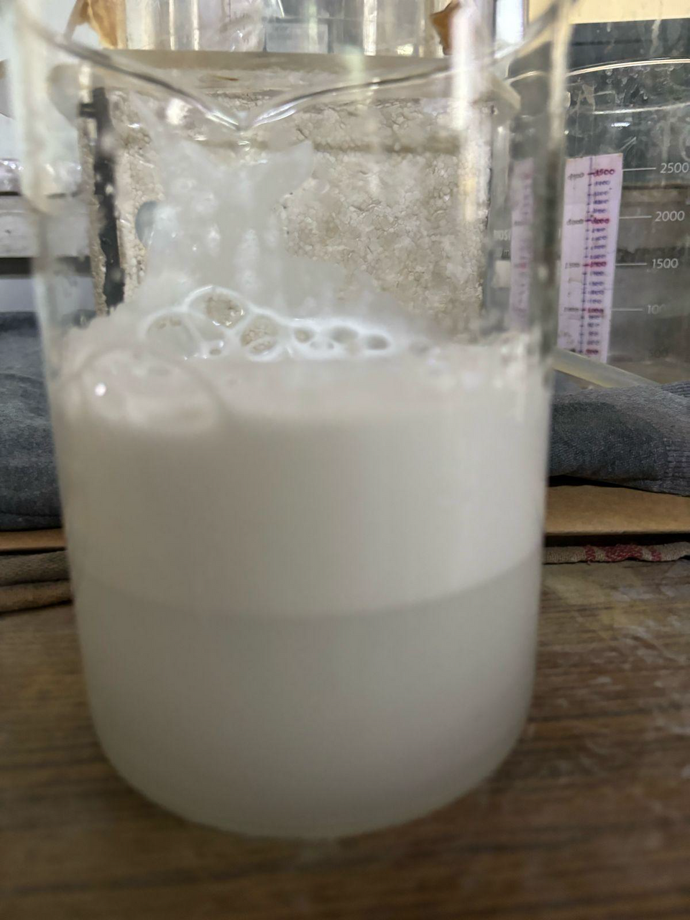
CGA PREPARED IN LAB

Slide 10
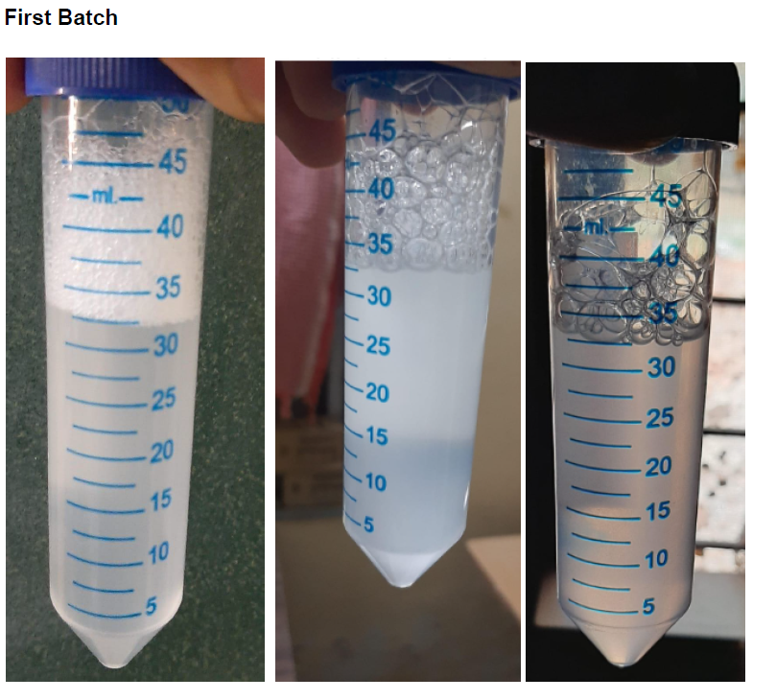
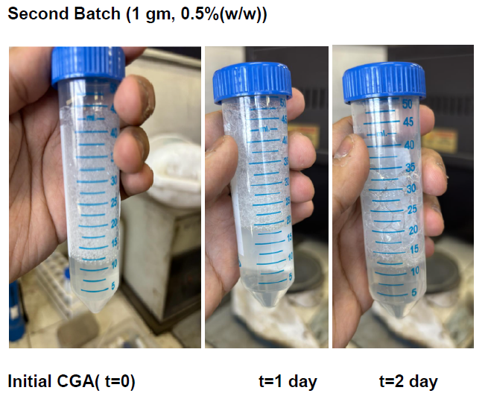

Slide 11
Observations
CMC solution:
CMC mixes with water up to a certain concentration using only heat and stirring( 2g/100ml).
At a higher concentration the viscosity of CMC increases a lot.
The CMC solution prepared without heat tends to be more viscous.
It also increases with time.
CGA with CMC solution:
stability is more than(lasts 4 days compared to 2 days) solution without CMC
stability of 0.5% is less than 1% solution
The CMC solution tends to settle down at the bottom

Slide 12
Conclusion
Successfully utilized carboxymethyl cellulose (CMC) as a viscosity enhancer for stabilizing CGAs.
Identified challenges like CMC solution gelation, prompting further exploration of alternative viscosity enhancers.
Solubility conditions optimization for CMC.

Slide 13
Future work
Implement Advanced Mixing Techniques: Utilize high-shear homogenization methods to ensure uniform distribution of additives.
Explore Alternative Viscosity Enhancers: Xanthum gum, carbomers etc.
Address Long-Term Stability Challenges: Incorporating stabilizers or cross-linking agents to reinforce the structural integrity of CMC molecules within the CGA solution.
Exploring hybrid systems that combine CMC with other compatible polymers or additives to synergistically enhance stability and rheological properties.

